Slide 1


Smart Layer 2 Ethereum
XpansionChain

Slide 2

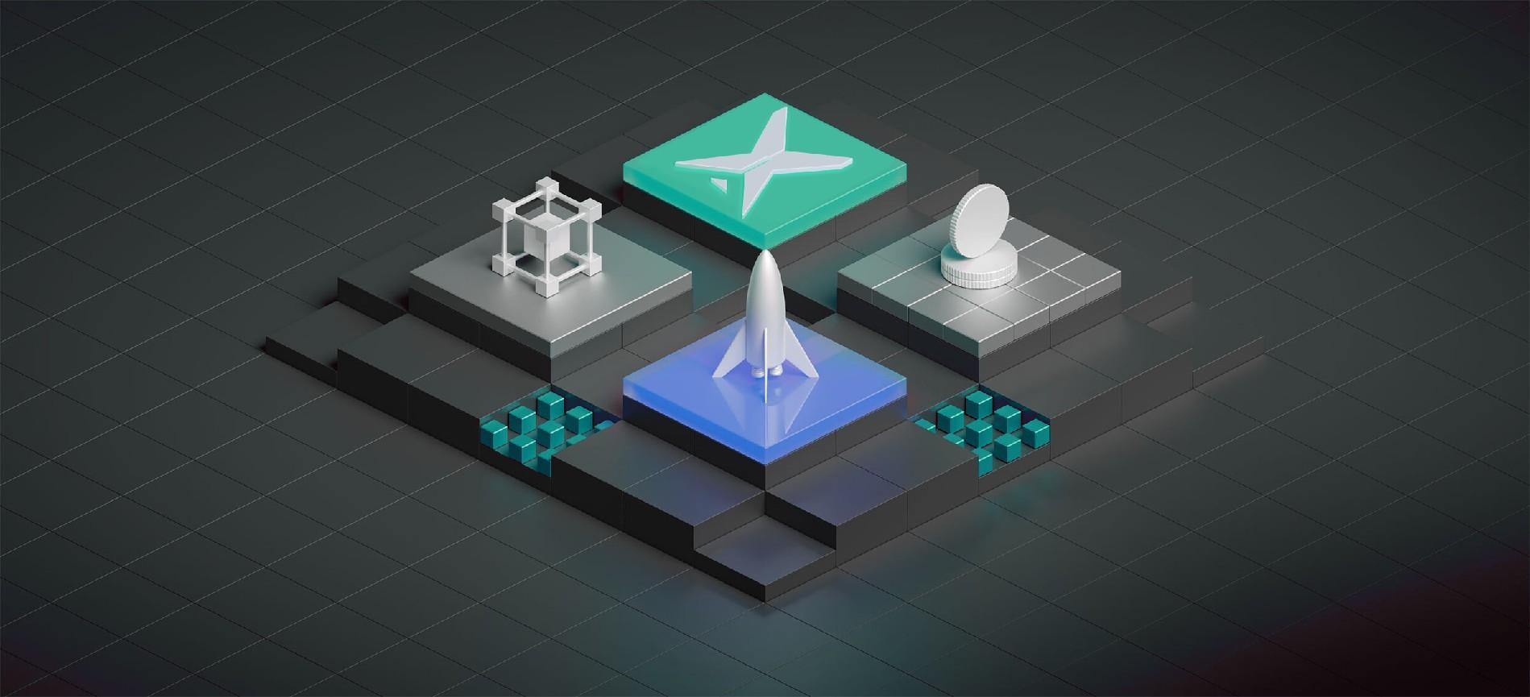

X
XpansionChain - a new generation of Ethereum expansion protocol
XpansionChain is a technology suite designed to scale Ethereum. You can use XpansionChain chains to do all things you do on Ethereum — use Web3 apps, deploy smart contracts, etc., but your transactions will be cheaper and faster. Our flagship product — XpansionChain Rollup — is an zk-Rollup protocol that inherits Ethereum-level security.
XpansionChain has been built with a modular architecture that combines an ZK-Rollup protocol with an innovative data availability solution. This allows XpansionChain to inherit security from Ethereum AND offer cheaper and more accessible data availability.

Slide 3


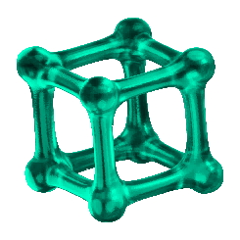

XpansionChain
Use the most powerful Layer2 protocol to
build your blockchain
XpansionChain, is designed for developers to build blockchains andapplications that solve today's real-world problems with the flexibility to capture tomorrow's opportunities
Permissionless & fully
decentralized
Auditable transparency
with privacy
Flexible with customizable
crypto-economy
Powered by the XpansionChain to leverage the security of a robust PoW，public blockchain with the largest distributed node network ensuring maximum reliability and resilience.
Zero-knowledge enabled cross chain protocol allowing auditable AND privacy-preserving blockchains bridging a major gap for real-world adoption.
All-in-one SDKs with a modular design allow developers to efficiently deploy fully customized private or public blockchains that meet their specific needs.

Slide 4
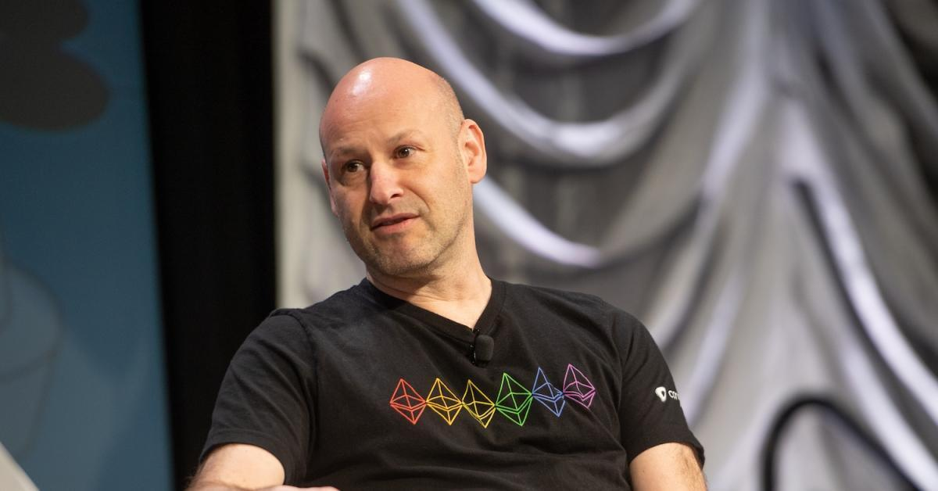




Joseph Lubin and XpansionChain
Joseph Lubin One of the most experienced founders of Ethereum, Lubin from the United Kingdom graduated from Princeton University in 1987 with a degree in electrical engineering and computer science. After graduating, Lubin pursued a diverse career in software engineering, music production, business, and finance. Later, Lubin became interested in cryptocurrencies and connected with fellow Canadian Di Iorio through the Canadian Bitcoin Alliance.
In 2014, when he was invited to join the co-founder group, he happily went there. At that time, he was in charge and proposed to use the C++ programming language to write the architecture of Ethereum, so he was mainly responsible for the technical part.
Later, after Joseph left the Ethereum community for a different development vision, Lubin founded the for-profit Ethereum development company ConsenSys, which launched a number of different projects on the network. An example is the well-known little fox wallet MetaMask. Because Joseph hopes to achieve commercial success, Consensys no longer only focuses on Ethereum open source development, but focuses more on building applications and incubating a large number of blockchain start-ups.
After the outbreak of DEFI in 2021, Ethereum no longer adapts to the current vigorous financial development due to high fees and congestion. Joseph Lubin joined the Layer2 track and founded XpansionChain to solve the problems of the current system. Currently, he has joined XpansionChain with more than 120+ web3.0 projects; Well-known projects such as CURVE SUSHI
Joseph Lubin
Ethereum
CURVE
SUSHI

Slide 5




Top investment
XpansionChain has raised more than 20 million US dollars, initial investors include a16Z, Ethereum Foundation, Web3 Foundation .
Based on the emphasis on XpansionChain, Joseph Lubin, the founder of ConsenSys Ventures, also serves as the project CEO, providing all-round support for the development of XpansionChain.

Slide 6
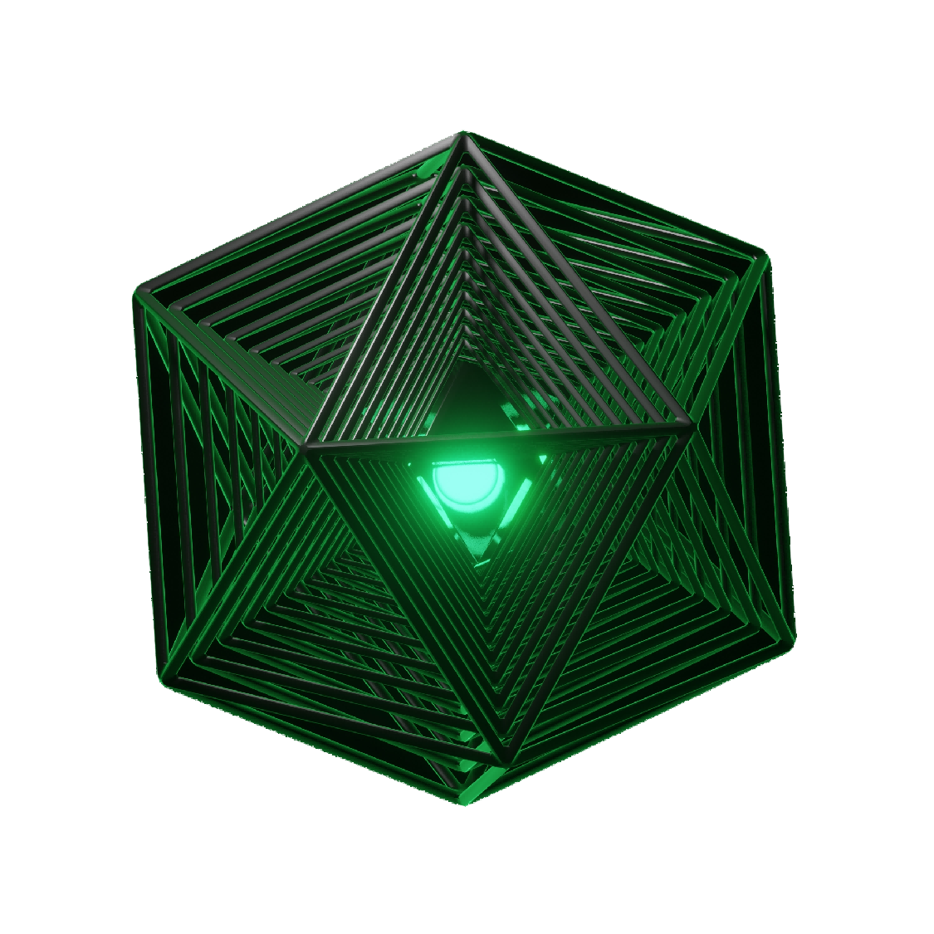

Technology
Architecture

Slide 7
Key Features Of The XpansionChain Network
Layer 2 solutions aim to improve blockchain scalability and performance without sacrificing security and decentralization features. They reduce the burden on the main chain and provide users with a faster and cheaper transaction experience by migrating part of the transaction and computing operations to the off-chain or parallel chain.
High performance: XpansionChain can handle a throughput of up to 3000TPS, which allows it to handle a large number of transactions without being affected by the congestion and delay of the Ethereum mainnet.
Low cost: XpansionChain provides low transaction fees, which means that users can conduct transactions at a lower cost, and at the same time attract more developers and users to join the XpansionChain ecosystem.
Openness: XpansionChain is an open ecosystem where anyone can build applications and tools while also having free access to the network.
Security: XpansionChain uses the ZK Rollup technology stack, which is a blockchain-based security mechanism that can ensure the decentralization and security of the network.

Slide 8
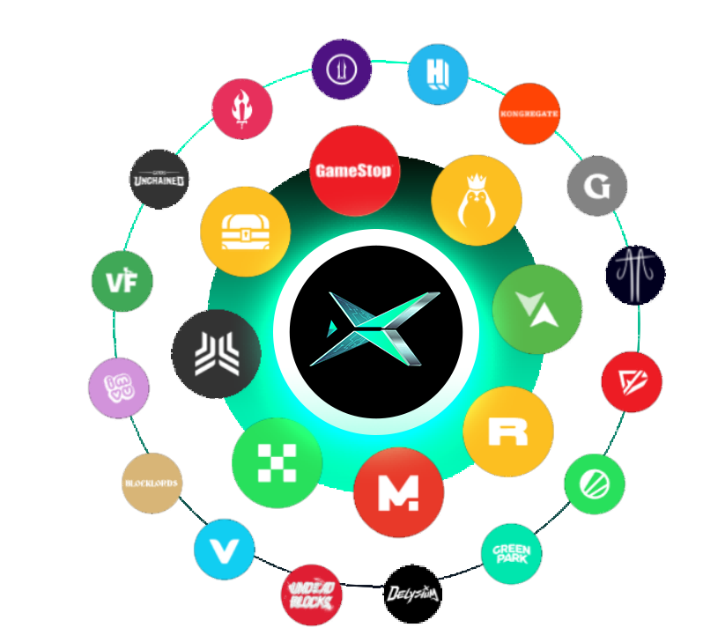

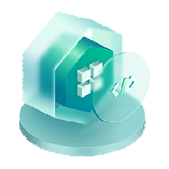

Scale at speed with a complete end-to-end solution
Access the global orderbook
Every time you list an asset with XpansionChain it is instantly distributed to multiple marketplaces
True scale for blockchain
XpansionChain is over 150x more efficient than Ethereum L1,enabling real-time minting,
transferring, and trading
Advice you can trust
Get the backing and advice of experts who have built some of the best web3 project in the world

Slide 9

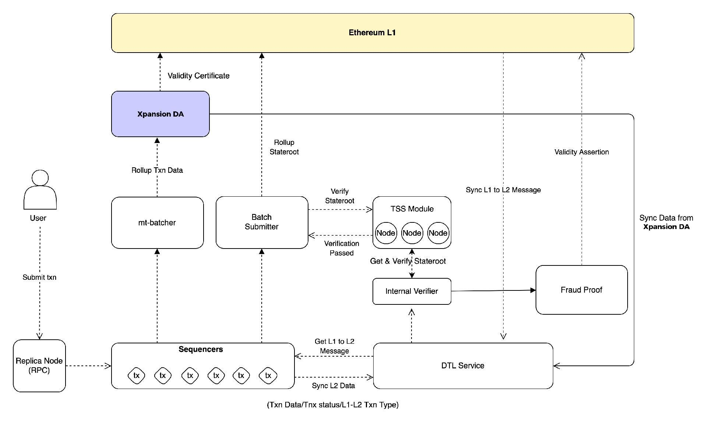
Network Architecture

Slide 10
Network Architecture
This diagram illustrates how different network modules and components interact with each other going through transaction execution and eventually published updated state data to Ethereum L1, and storing the rollup data on the XpansionChain Data Availability (DA) powered by EigenDA technology. Let's go over the process of transaction handling to better understand how each module works.
Users send signed transactions via an available RPC node.
The Sequencer receives transactions and pack them into blocks. The DTL (Data Transport Layer) service syncs this block data. Verifiers sync the L2 block data from the DTL.
The batch submitter fetches updated state roots and sends them to the Threshold Signature Scheme (TSS) module to be verified and signed. Verifiers can also fetch the state root data and confirm their validity.
Once TSS nodes establish the validity of the updated state roots and sign off on the rollup batches, the batch submitter publishes the state root data to the State Commitment Chain (SCC) contract on L1 Ethereum.
The rollup transaction data is stored on XpansionChain DA. Verifiers can fetch this data at any point and verify its validity. This action is performed when issuing fraud proof challenges.
XpansionChain DA nodes also post the validity certificates to L1 guaranteeing liveness and availability with each new batch.
In case the state root validity is challenged with a fraud proof, L2 data is posted to the contract on L1 to perform the execution and check state transition validity.

Slide 11
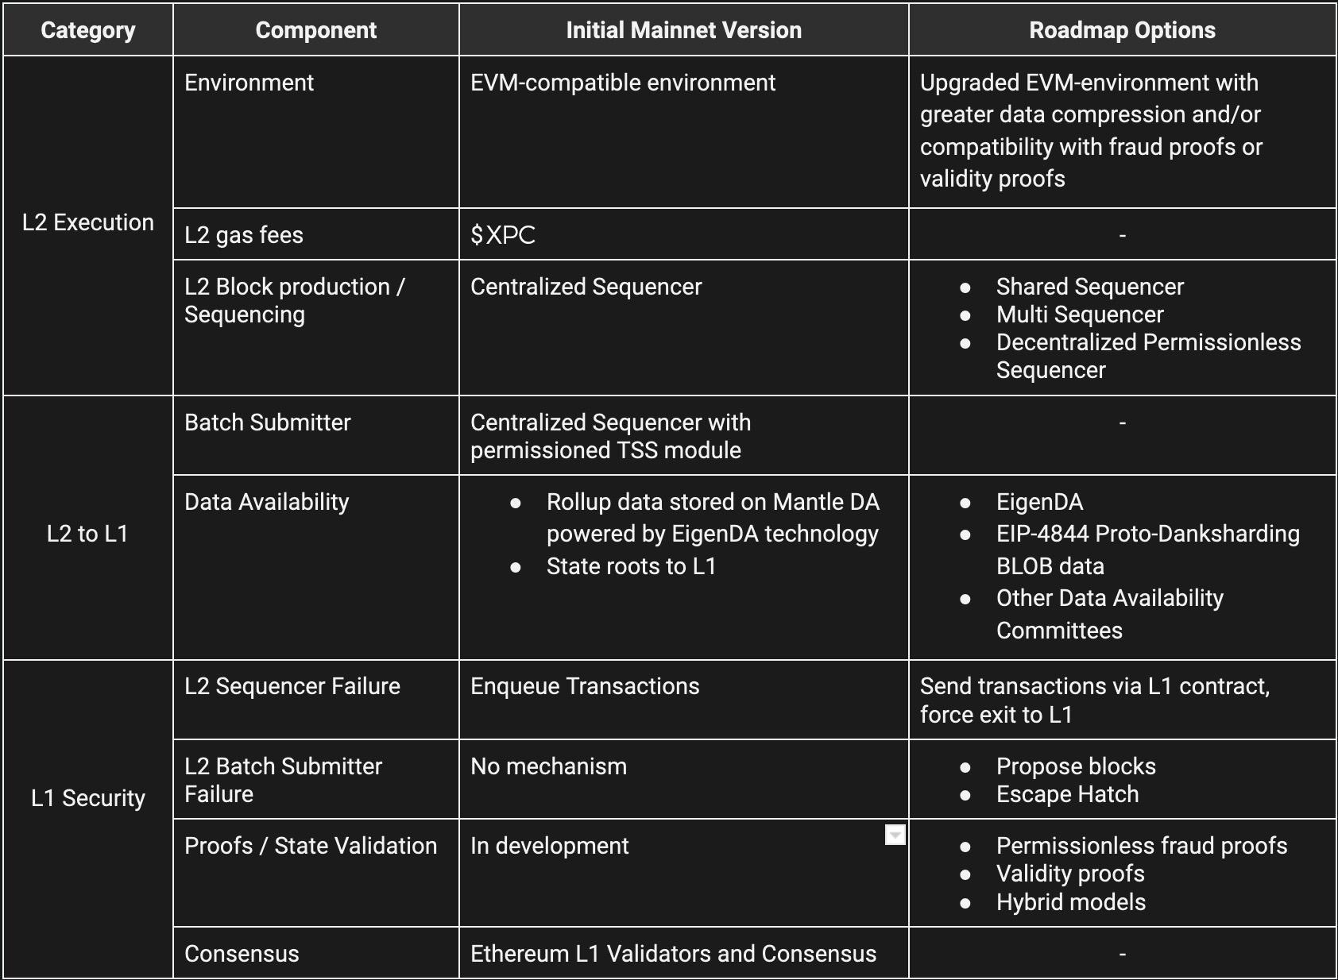

Route map

Slide 12

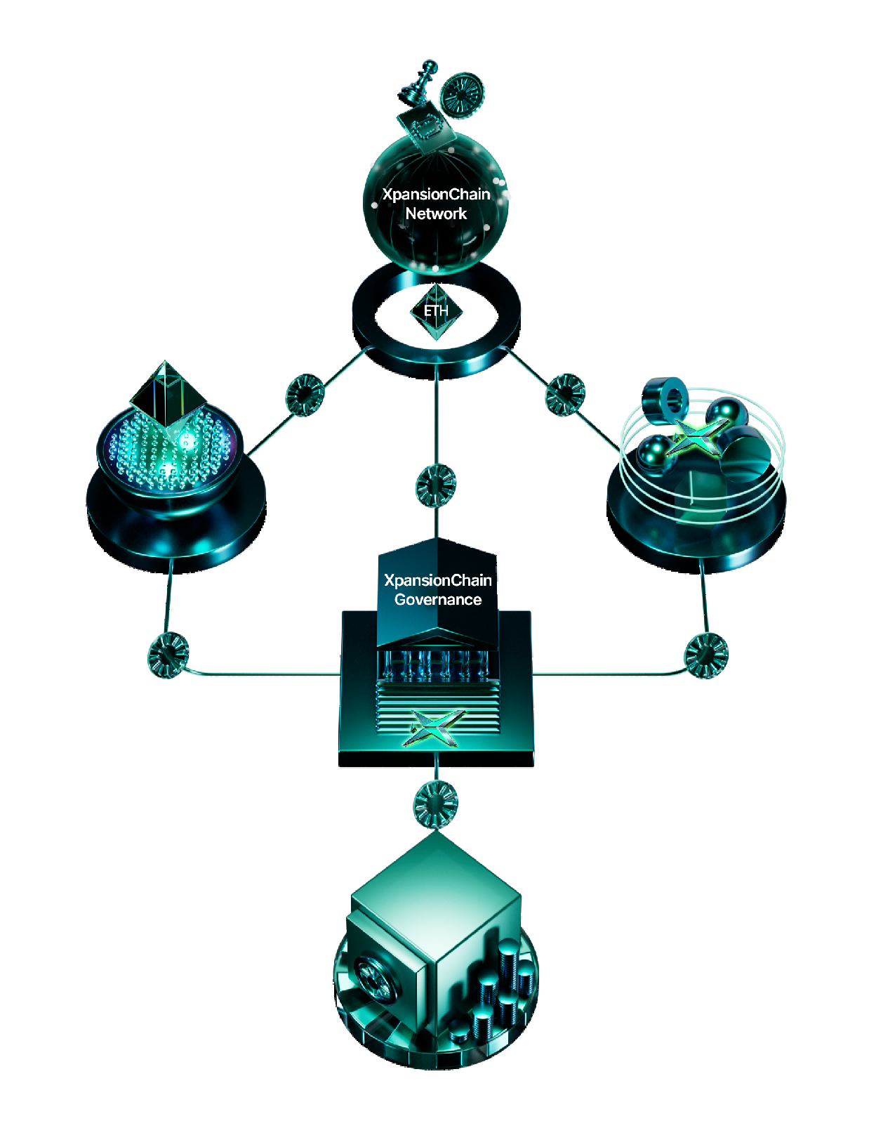
X-CHAIN Ecosystem

Slide 13

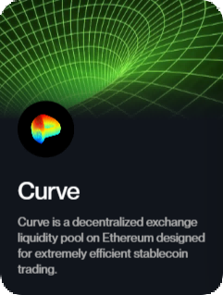
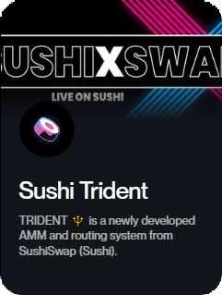
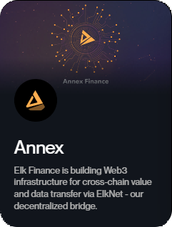
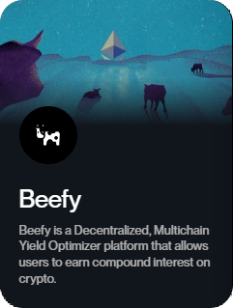
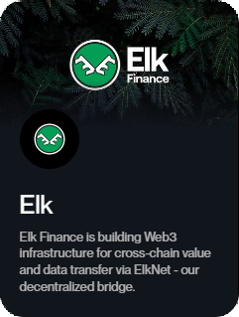
Ecosystem
XpansionChain’s unique architecture allows for the free flow of users, assets, and projects into the XpansionChain Ecosystem.
Deploy on XpansionChain and earn your share of $750M in transparent, on-chain incentives.
https://xchain.trade/XpansionChain/developer-rewards.html

Slide 14


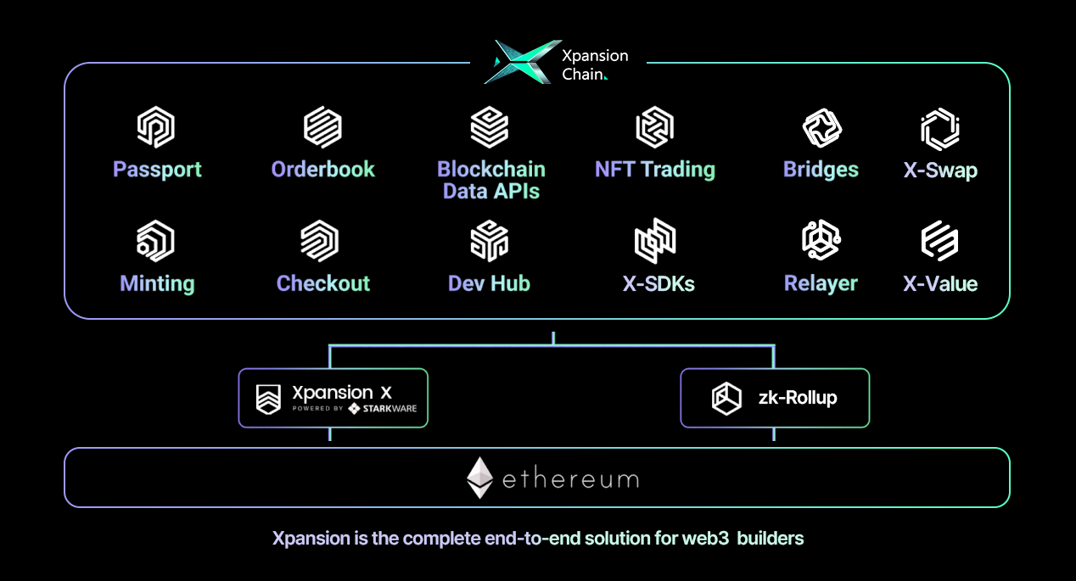
Product Roadmap

Slide 15


Freedom is our mission
XpansionChain is the layer 2 protocol that scales Ethereum's security and values through zero-knowledge cryptography. We believe that the single most impactful way we can make this world better is by increasing people’s freedom, and today, freedom relies on cryptography.
The mission of XpansionChain is to accelerate the mass adoption of crypto for personal sovereignty.
Ethereum is the most decentralized blockchain, capable of bringing sovereignty to billions of people. XpansionChain scales Ethereum’s security and its values of trustlessness, permissionless access, censorship resistance, resiliency through decentralization and community ownership.

Slide 16

Development
Bottlenecks
Opportunities

Slide 17


Develop
In December 2022, the XpansionChain test network will be launched. In just half a year, 120+ Dapps have been tested on the test network, becoming the Layer 2 project with the most B-side applications in the response and deployment project ecosystem.
The TVL of the XpansionChain deployment project has exceeded 500 million US dollars .

Slide 18

Opportunity
With the rapid development of WEB3.0, the performance of Ethereum and the high transaction fee have seriously restricted the innovation speed of applications. XpansionChain is compatible with the convenience provided by Ethereum EVM for the rapid deployment of applications. At the same time, the highly adaptable streaming payment service is undoubtedly the best solution, which has driven the demand from other ecosystems to provide streaming payments for more public chains and even cross-chains. Service is the next milestone of XpansionChain
Due to the rigid demand for cross-chain applications, it is inevitable that XpansionChain will develop towards multi-chain, and it will also become the infrastructure for bridging multiple public chains and Ethereum, which will bring considerable allies and users to XpansionChain
Users will be able to use services on the EVM Chain outside of Ethereum. In order to continuously improve the trading experience, XpansionChain will cooperate deeply with Eclipse and use ZK Rollup technology to make the transaction speed up to 3000+ TPS and achieve a higher execution speed than L1

Slide 19

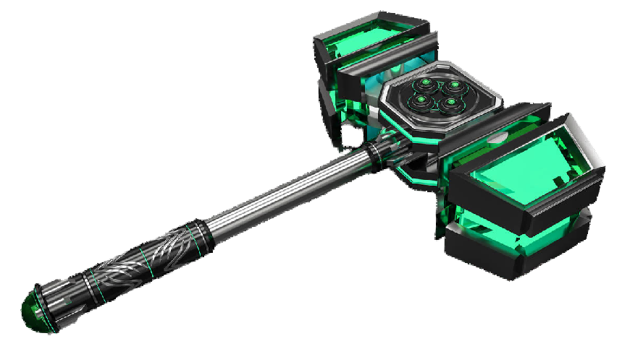
XpansionChain Community
Themis Gavel
Participate in the construction of the XpansionChain super community, and obtain community equity certificates that can be exchanged for XPC after the XpansionChain mainnet is launched, at the same time receive NFT rewards
XpansionChain DAO Organization and Ecological Governance Credentials

Slide 20

XPC Token
There will 1,000,000,000 Xpc tokens, provisionally allocated to the following areas:
Party/Purpose
Allocation
Description
Ecosystem
development
Allocated portion for user rewards, developergrants, liquidity provision and marketingpurposes.
55%
Allocated to the development of theXpansionChain protocol.Development to be conducted by the serviceprovider, XpansionChain. Pty. Ltd.
Project
Development
6.7%
DAO Airdrop
5.3%
Allocated to private sale investors bothinstitutional and individual.
Public sale
14%
Allocated to the XPC public sale.
Allocated to ecosystem-development relatedinitiatives, mainly liquidity provision for exchanges (centralised and decentralisedvenues).
Foundation
reserve
19%

Slide 21


XPC system
XPC is the incentive certificate of XpansionChain ecology, which aims to motivate the participants in the community to build the ecology together, and further obtain more income from the XpansionChain ecosystem, which is the embodiment of the contribution value of the participants to the ecological construction. Staking, recommending, participating in the XpansionChain protocol, and participating in specific tasks will all get XPC.

Slide 22


XpansionChain Horizon
public offering plan
Participate in obtaining XpansionChain DAO community NFT to enjoy early XPC tokens
https://medium.com/@xpansionchain

Slide 23



Rollup customized for applications provides Layer 1 security and customizability of application chains. However, a common problem with Rollups today is that they mostly operate with centralized sorters and generate decentralized liquidity and user bases. We find XpansionChain's approach of facilitating application-customized Rollup launches via EigenDA to be an inspiring one. Their core network helps thousands of Rollup applications to quickly access the Ethernet network, reducing deployment and development costs. All of this dramatically shortens the time-to-market and encourages rapid innovation and experimentation.
Nicola W
Binance Labs Investment Director

Slide 24
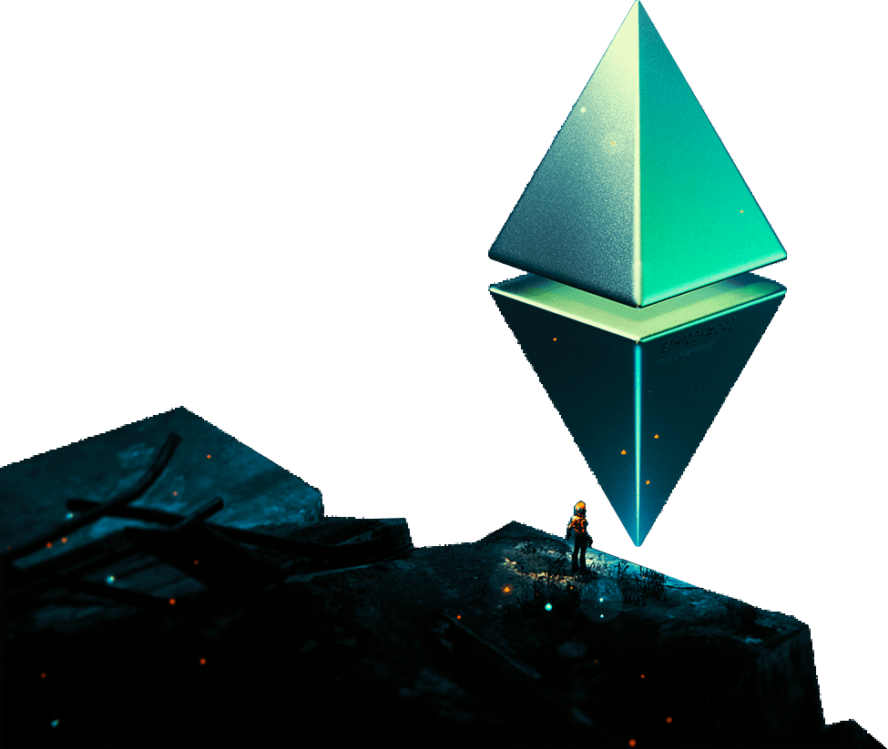


XpansionChain
WEBSITE:https://xchain.trade/
Twitter:https://twitter.com/XpansionChain
LINK:https://link3.to/3ZYMZV7V
Thanks

